Slide 1
Development - 2 Numera Younus

Slide 2
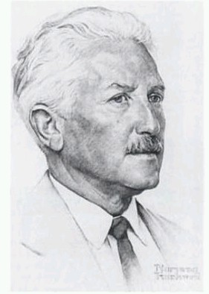
Erickson’s Theory of Psychosocial Development

Slide 3
Psychosocial Development Theory
Psychosocial development theory is based on eight stages of development
Erikson’s theory is based on the idea that development through life is a series of stages which are each defined by a crisis or challenge
The early stages provide the foundations for later stages so if a child does not resolve a crisis in a particular stage, they will have problems in later stages

Slide 4
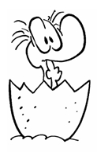
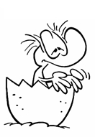
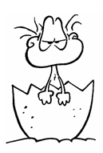
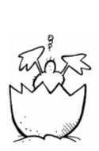
Stage 1: Trust vs. Mistrust
Infancy (birth to 12 -18 months)
Caregiver meets needs: child develops trust
Caregiver does not meet needs: child develops mistrust
If the proper balance is achieved, the child will develop the virtue of hope.
Mama? Papa?

Slide 5
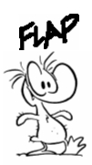
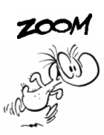
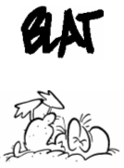
Stage 2: Autonomy vs. Shame & Doubt
Toddler (ages 1-3)
Child able to exercise some degree of choice
Child’s independence is thwarted: child develops feelings of self-doubt, shame in dealing with others
Basic Strength: Will
Determination to exercise freedom of choice in face of society’s demands. In other words, it's the confidence that they can make choices and decisions while respecting the rules and boundaries set by others.
Up, up and away?

Slide 6
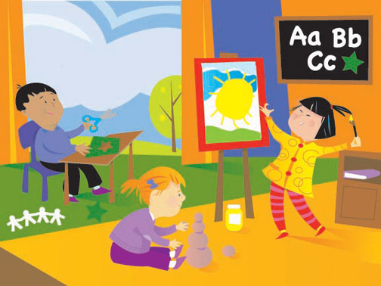
Stage 3: Initiative vs. Guilt
Preschool (3 to 5 years)
Children begin to plan activities, make up games, and initiate activities with others.
Children who are successful at this stage develop a sense of initiative & feel capable and able to lead others.
Those who fail to acquire these skills are left with a sense of guilt & self-doubt
Basic strength: Purpose
Courage to imagine and pursue goals

Slide 7
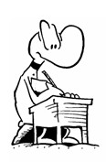
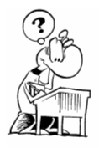
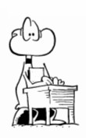
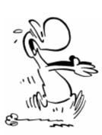
Stage 4: Industry vs. Inferiority
School age (6 to teens)
Child develops cognitive abilities to enable in task completion (school work, play)
Successful completion leads children to develop a feeling of competence and belief in their skills.
Those who are unsuccessful doubt their ability to be successful.
Basic strength: Competence
Exertion of skill and intelligence in pursuing and completing tasks
Scared of school?

Slide 8
Stages 1-4
Largely determined by others (parents, teachers)
Stages 5-8
Individual has more control over environment
Individual responsibility for crisis resolution in each stage

Slide 9
Stage 5: Identity vs. Role Confusion
Adolescence (teens to 20's)
A common question adolescents ask is a straight-forward question of identity: "Who am I?"
During adolescence, children are exploring their independence and developing a sense of self. They form their identity based upon the outcome of their explorations
Those who receive proper encouragement and reinforcement will emerge from this stage with a strong sense of self and a feeling of independence and control.
Those who remain unsure of their beliefs and desires will insecure and confused about themselves and the future.
Basic strength: Fidelity - means loyalty, the ability to live by society’s standards despite their imperfections and incompleteness and inconsistencies.
Notes:
Fidelity means that you have found a place in that community, a place that will allow you to contribute.

Slide 10
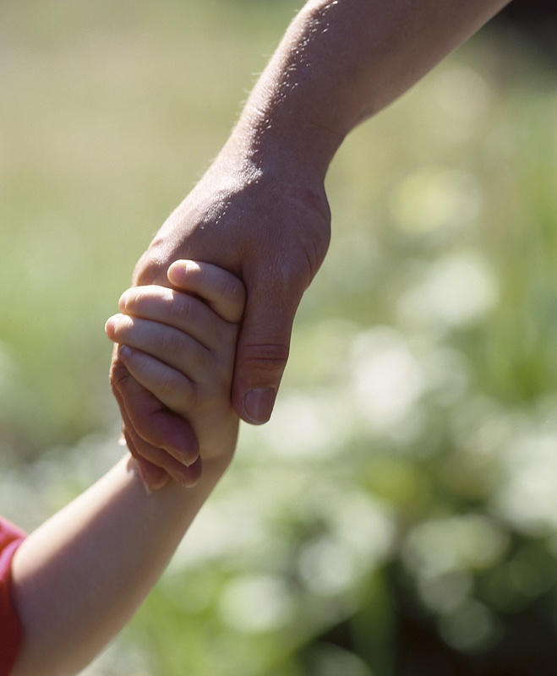
Stage 6: Intimacy vs. Isolation
Young adulthood (20's to 35-40 years)
Undertake productive work and establish intimate relationships
Inability to establish intimacy leads to social isolation
Basic strength: Love
Mutual devotion in a shared identity
Fusing of oneself with another person

Slide 11
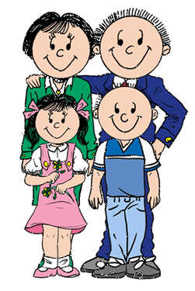
Stage 7: Generativity vs. Stagnation
Middle adulthood (40 to 60 years)
Generativity: Interest in guiding the next generation
Stagnation: When one is only concerned with one’s own needs and comforts
Basic strength: Care
Broad concern for others
Need to teach others

Slide 12
Stage 8: Integrity vs. Despair
Late adulthood (from 60 years)
This stage is focused on reflecting back on life.
Those who feel proud of their accomplishments will feel a sense of integrity. Success at this stage leads to feelings of wisdom.
While failure results in regret, bitterness, and despair.
Basic strength: Wisdom
Detached concern with the whole of life

Slide 13
https://www.youtube.com/watch?v=aYCBdZLCDBQ&t=39s

Slide 14
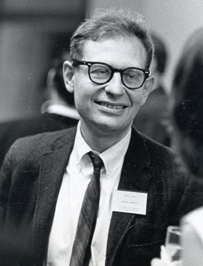
Kohlberg’s Theory of Moral Development

Slide 15
Lawrence Kohlberg's ideas of moral development are based on the premise that at birth, all humans are void of morals, ethics, and honesty.
He identified the family as the first source of values and moral development for an individual.
He believed that as one's intelligence and ability to interact with others matures, so does one's patterns of moral behavior
Kohlberg believed...and was able to demonstrate through studies...that people progressed in their moral reasoning (i.e., in their bases for ethical behavior) through a series of stages.
He believed that there were six identifiable stages which could be more generally classified into three levels.

Slide 16
Heinz Dilemma
Heinz's wife was near death, and her only hope was a drug that had been discovered by a pharmacist who was selling it for an exorbitant price. The drug cost $20,000 to make, and the pharmacist was selling it for $200,000. Heinz could only raise $50,000 and insurance wouldn't make up the difference. He offered what he had to the pharmacist, and when his offer was rejected, Heinz said he would pay the rest later. Still the pharmacist refused. In desperation, Heinz considered stealing the drug. Would it be wrong for him to do that?
Should Heinz have broken into the store to steal the drug for his wife? Why or why not?

Slide 17
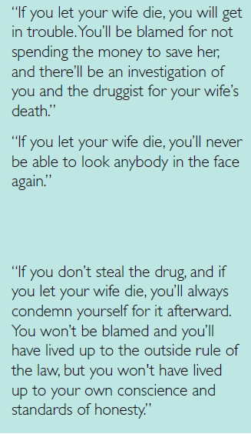
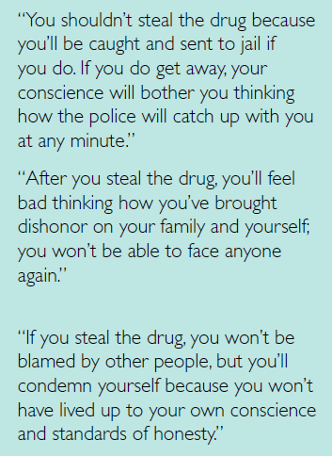

Slide 18
Kohlberg’s Levels of Moral Development
Preconventional
Conventional
Post-conventional
Follows rules to avoid punishment Acts in own interest and obedience for its own sake
Selfchoosen principles of justics Aware of diversirty Contingency approach Balance individual and social concerns
Good citizen Law and order Social Expectation
1
2
3

Slide 19
Pre-conventional Level
At this level a person’s view of right and wrong is usually influenced by their family, mainly their parents and older siblings, and the consequences attached to their behavior.
Right or wrong is identified in terms of what results in rewards and punishments
If one of these authority figures is morally and ethically corrupt, there is a good chance the child will be to.
The individuals who stay at this level often refuse to believe his/her family member did something wrong, even when the evidence is overwhelming. Parents will defend children, individuals will defend siblings, wife's/ husbands will defend their spouse and children will defend their parent’s unethical behavior.

Slide 20
Stage 0: Egocentric Judgment
“The child makes judgments of good on the basis of what he likes and wants or what helps him, and bad on the basis of what he does not like or what hurts him. He has no concept of rules or of obligations to obey or conform independent of his wish.” (Kohlberg, 1971)

Slide 21
Stage I: Punishment-Obedient Orientation
What is right is to obey the rules, avoid physical damage to persons and property.
At this stage, children see rules as fixed and absolute.
The reason is that one wants to avoid punishment.

Slide 22
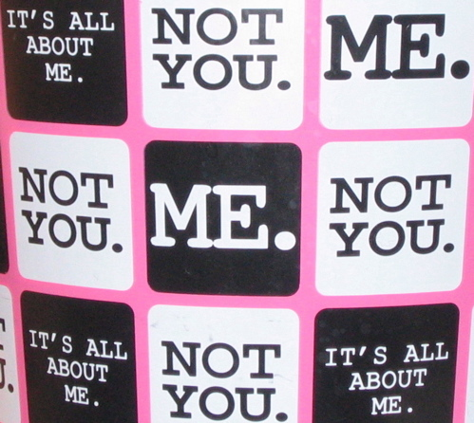
Stage II: Self-Interests.
Right action consists of what instrumentally satisfies one’s own needs and occasionally the needs of others.
Human relations are viewed in terms such as those of the market place (morality as an exchange between two market entities to gain a benefit).
Elements of fairness, reciprocity, and equal sharing are present, but they are always interpreted in a physical, pragmatic way.
For example, a child at this stage might believe that it's wrong to steal because if they get caught, they will be punished. This is a pragmatic understanding of the rules based on avoiding physical harm or immediate punishment.
Reciprocity is a matter of ‘you scratch my back and I’ll scratch yours’

Slide 23
Conventional Level
Young people have internalized the ethical and moral beliefs of their family and the group they associate with.
Concerned with fulfilling role expectations, maintaining and supporting the social order, and identifying persons or groups involved in this order.

Slide 24
Stage III: The Interpersonal and Conformity
Individual's moral judgment is motivated by a need to avoid rejection, disaffection, or disapproval from others
Good behavior is what pleases or helps others and is approved by them.
One earns approval by being ‘nice’

Slide 25
Stage IV: Authority and Maintaining Social Order
Individual's moral judgment is motivated by a need to not be criticized by a true authority figure.
Becomes aware of the wider rules of society.
“The individual is oriented toward authority, fixed rules, and the maintenance of the social order. Right behavior consists in doing one’s duty, showing respect for authority, and maintaining the given social order for its own sake.” (Kohlberg, 1971)

Slide 26
Post-conventional Level
A person at this level makes his/her ethical decisions based on what any reasonable person would know as right and wrong.
These decisions are based on universal ideals of justice or human rights or human welfare
Define moral values on own values (do not rely on authority’s definition)

Slide 27

Stage V: Social Principles Contract
At this stage, individuals recognize the importance of societal norms and laws in maintaining order and fairness, but they also acknowledge that these rules can be changed if they don't serve the greater good.
Moral decisions in Stage 5 are based on an understanding of the social contract, which involves an agreement among individuals to follow rules that promote the welfare of society.
People at this stage may question and even challenge existing laws and rules if they believe those rules are unjust or do not uphold individual rights and societal well-being.
Moral reasoning in Stage 5 is largely driven by a concern for the balance between individual rights and the common good. People recognize the need for social order but are willing to change or challenge laws when they conflict with fairness and justice.

Slide 28
Suppose there is a debate about privacy rights in a society. In Stage 5, an individual might argue that while privacy is important, there must be limits on it for the sake of national security. They recognize that some restrictions on privacy, like government surveillance, are necessary to maintain social order and protect the common good. They understand that individual rights should be balanced with societal needs and the rule of law.

Slide 29
Stage VI: Universal Principles of Conscious
It represents the highest level of moral development according to Kohlberg. It's also known as the "Universal Ethical Principles" stage.
At this stage, individuals have a well-defined and fully developed set of ethical principles that transcends societal norms, laws, or the social contract. These principles are deeply internalized and guide their moral decision-making.
Moral decisions in Stage 6 are made based on a commitment to abstract, universal principles of justice, ethics, and morality. These principles are seen as absolute and applicable in all situations.
People in Stage 6 are willing to act in ways that align with their deeply held ethical principles, even if it means going against societal norms or laws. They prioritize moral values above all else.
This stage represents the most advanced and principled form of moral reasoning in which individuals have a strong sense of personal integrity and a commitment to the highest ethical standards.

Slide 30
An individual at Stage 6 might find themselves in a society where there's a law that discriminates against a particular ethnic group. Despite this law being legal in that society, the person in Stage 6 would strongly oppose it because it violates their deeply held principles of justice, equality, and human rights. They believe that such discrimination is morally wrong, irrespective of the legality of the law, and would be willing to take a stand against it, even if it means facing legal consequences.

Slide 31
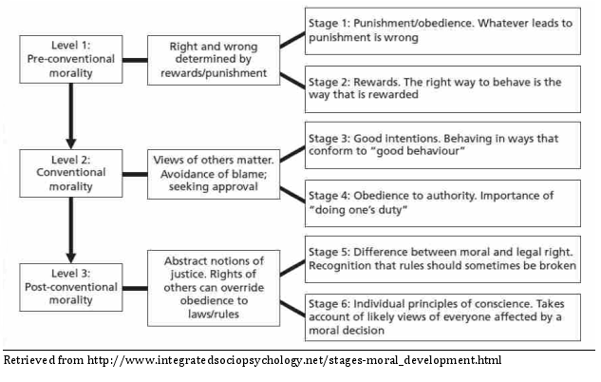

Slide 32
Stage?
If Katy is nice to me, I'll be nice to her, but if she is mean to me, I won't feel bad about being mean too.
"We shouldn't consider war..." "because we'll have more money for domestic issues...“
"We should consider war" "because we can gain security of the oil supply..."
Stage 2

Slide 33
Stage?
It would be bad for me to take my friend's toy because the teacher will punish me
"We shouldn't consider war..." "because it would hurt our economy..."
"We should consider war" "because our oil is threatened...."
Stage 1

Slide 34
Stage?
I better not drink and drive because my friends will think less of me and I, in turn, will think less of myself.
"We shouldn't consider war..." "because we don' t want to appear too militaristic...“
"We should consider war" "because we don't want the world to see us as weak...."
Stage 3

Slide 35
Stage?
I am personally against the war, but would never publicly protest it on campus without the administration's permission.
"We shouldn't consider war..." "because war is killing and killing is against the law...“
"We should consider war" "because the U.N. has laid down written resolutions which should be upheld..."
Stage 4

Slide 36
https://www.youtube.com/watch?v=bounwXLkme4

Slide 37
Thanks!
Any questions?

